Slide 1
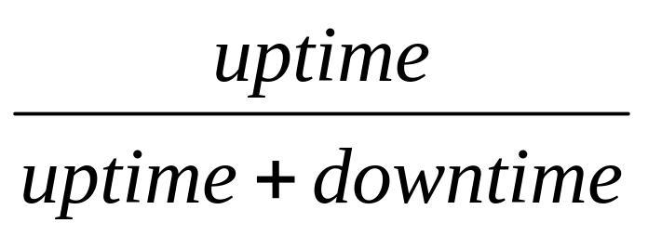
Chapter 11
Availability
Concepts and Definitions (11.1)
Exponential Model (11.2)
System Availability (11.3)
Inspect and repair Model (11.4)
Notes:
For systems that are restored upon failure, a meaningful performance measure is the percent of time that the system is operating. This measure depends upon both the time between failures and the time to repair. It therefore combines system reliability and maintainability. Historical, this measure is determined by computing the percent of time that the system was operating. Our interest, however, is in prediction.

Slide 2
11.1 Concepts and Definitions
Definition: Availability is the probability that a system or
component is performing its required function at a given point in time or over a stated period of time when operated and maintained in a prescribed manner.
Chapter 11
Notes:
A formal definition.

Slide 3
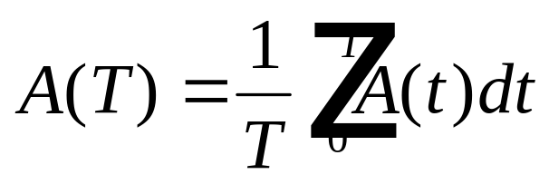
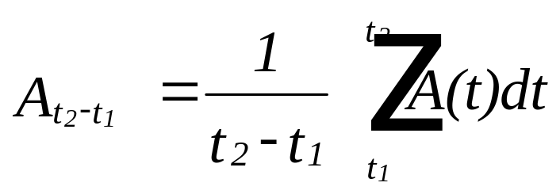
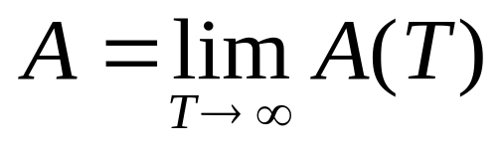
Availabilities
1. A(t) = the availability at time t - referred to as the
point availability
2.
is the average availability over [0,T]
generalize:
3.
is the steady-state availability
Chapter 11
Notes:
There are 3 interpretations of availability. A point availability, an interval availability, and a steady-state availability.

Slide 4
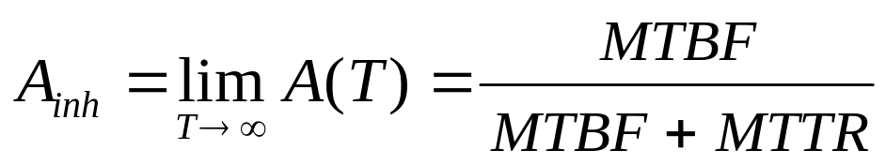
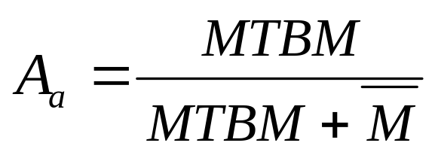
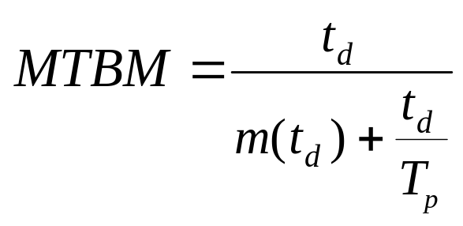
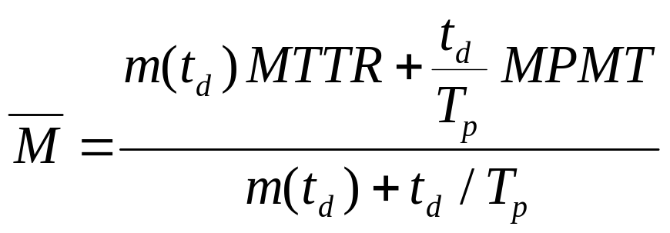
Steady-State Availability
To have steady-state, a renewal processes is necessary
1. Inherent
2. Achieved
Chapter 11
Notes:
In order for a system to reach a steady-state, a renewal process is necessary. Otherwise the system availability will continue to change over time. There are several ways of defining a steady-state availability. Inherent availability is based upon the MTBF and MTTR. Achieved availability also includes preventive maintenance downtime.

Slide 5
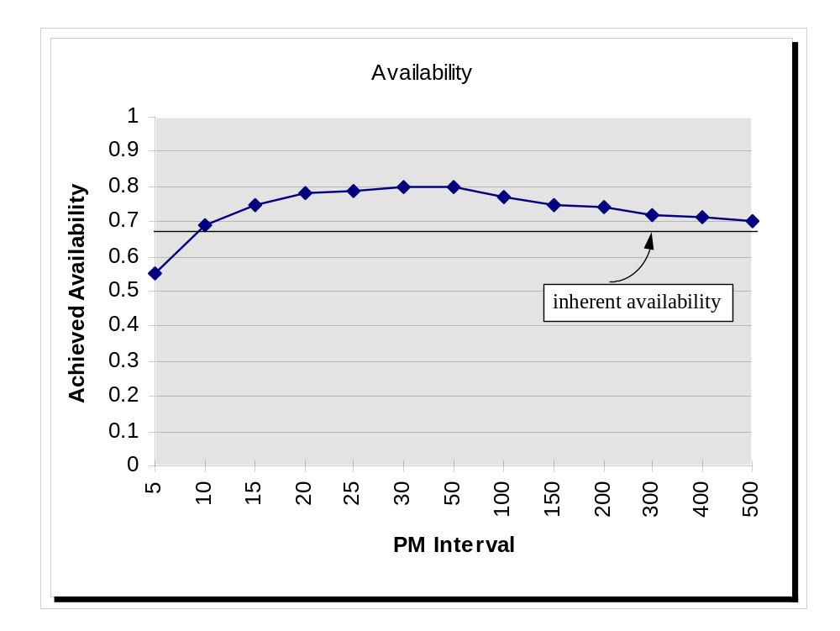
Achieved Availability
MTBF = a + b/T_{pm}
Chapter 11

Slide 6
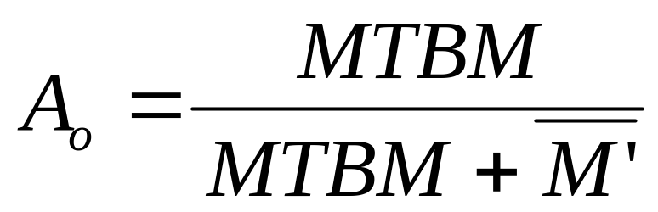
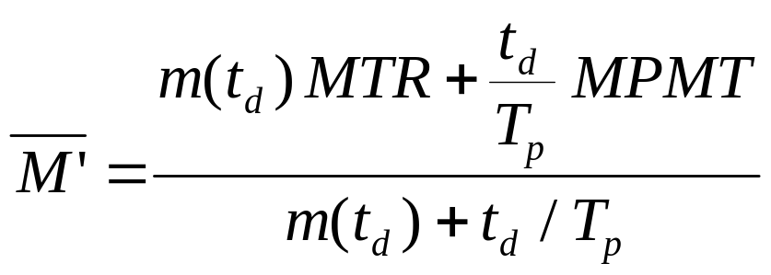
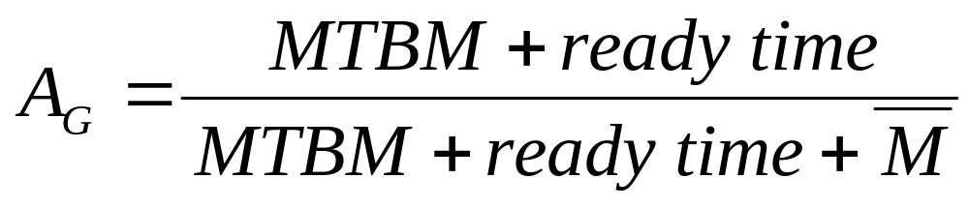
Operational Availability
and MTR = MTTR+SDT+MDT
Chapter 11
Notes:
A third measure of steady-state availability is the operational availability. Operational availability includes the mean time waiting for resources (MDT) and spares (SDT) as part of the downtime. If the MTBM is measured in operating time, then the ready time accounts for system up time when the system is available but in use (operating). Operational availability is a useful measure when the organization is responsible for providing maintenance and spare parts.

Slide 7
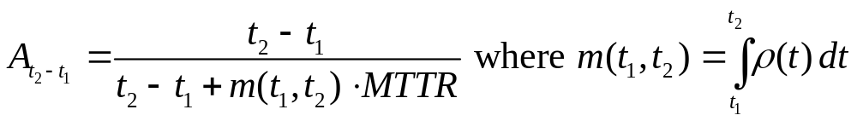
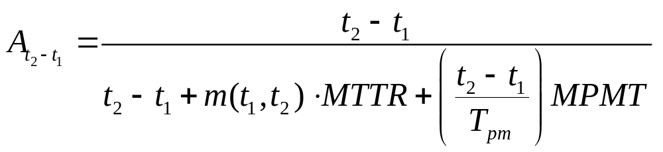
Availability with Minimal Repair
Inherent Availability
Achieved Availability
Chapter 11

Slide 8
Availability with Minimal Repair
A machine has minimal repair upon failure with an
intensity function of ρ(t) = .00017t^{.7}, t measured in
days. Repair times are lognormal with a median repair
of 20.3 hours and s=1.2. Estimate its availability over
its first 5 operating years assuming 7/24.
m(t) = .0001t^{1.7} and m(5 x 365) = 35.0
MTTR = 20.3 exp[1.2² /2] = 41.7 hrs = 41.7/24 = 1.74 days
A(5 oper yrs) = 5 x 365 / [5 x 365 + 35 x 1.74] = .9677
Chapter 11
Notes:
Under minimal repair, availability can be estimated over some specified time period, t, such as a design life or economic life. The total downtime over time t is determined by multiplying m(t) expected failures times the average downtime.

Slide 9

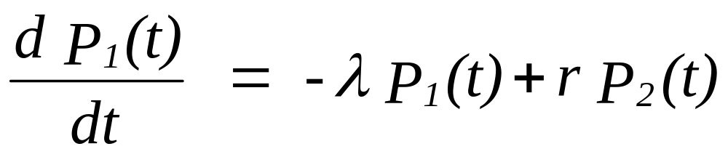
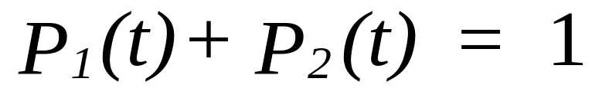
11.2 Exponential Model
1
2
r
Chapter 11
Notes:
Not surprisingly, the exponential failure and repair distributions are the simplest that can used in computing all three measures of availability. For a single CFR component having a constant repair rate, r, two states are defined: an up-state (1) and a down-state (2). Using the Markov analysis approach, the two equations shown are constructed.

Slide 10
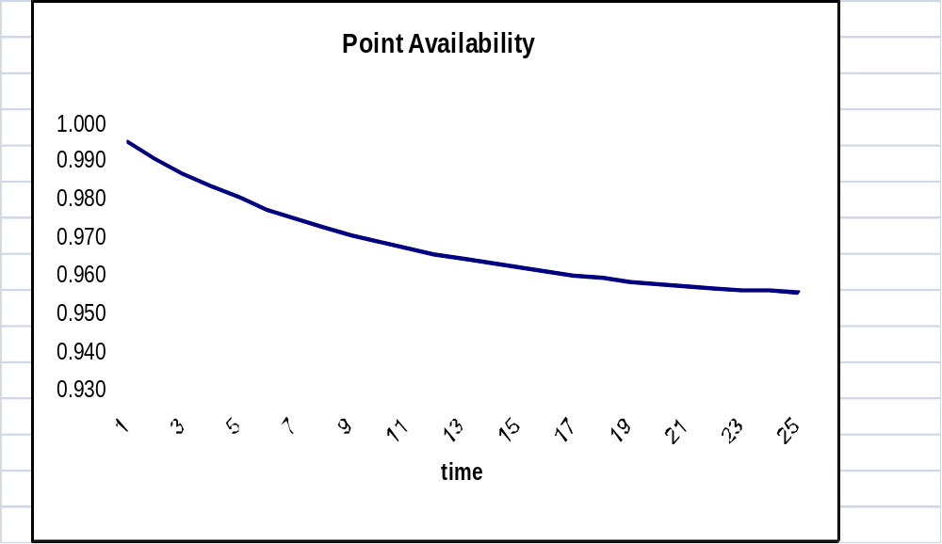
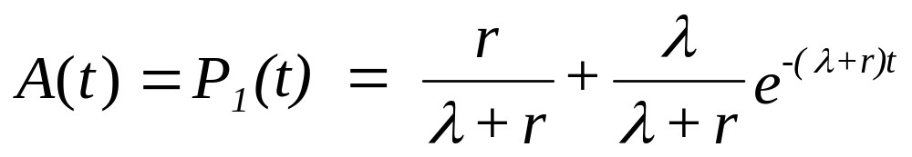
Exponential Model
Chapter 11
Notes:
Solving the equations, P₁(t) is obtained. Since this is the probability of being in state 1 at time ti, it is also the point availability.

Slide 11
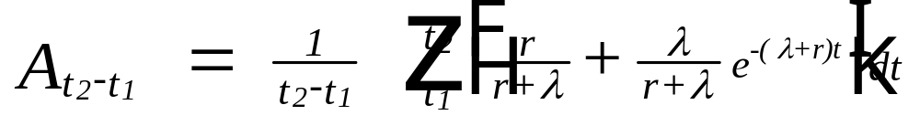
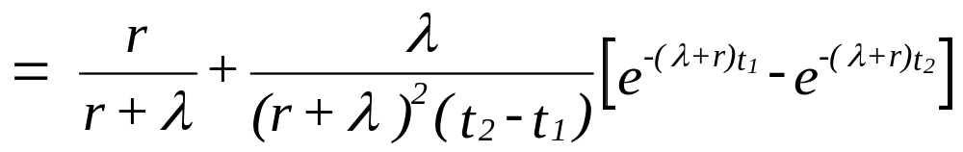
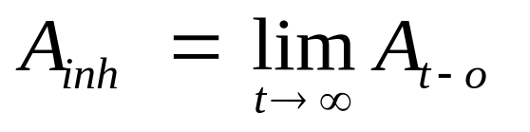
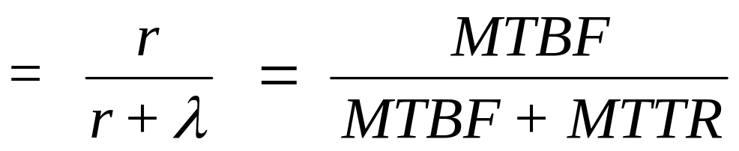
Exponential Model - Interval Availability
steady-state
Chapter 11
Notes:
An interval availability is derived by integrating the point availability. Then taking the limit, a steady-state availability is obtained. The steady-state availability is, of course, the inherent availability.

Slide 12
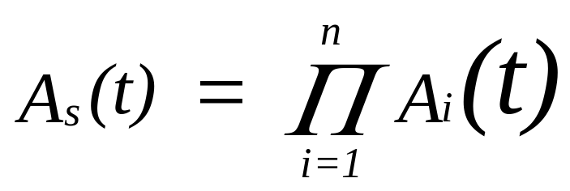

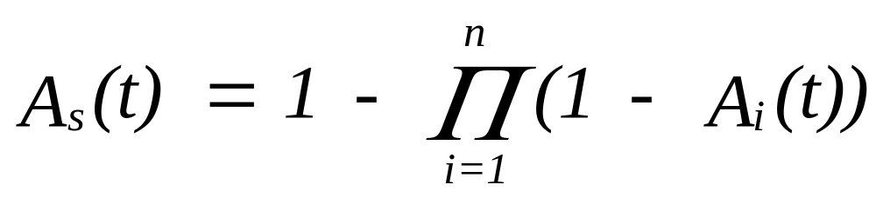
11.3 System Availability
Series versus Parallel
Chapter 11
Notes:
Since availability is a probability, the basic rules of probability still apply. For components in series or parallel, the corresponding system availability is computed in the same way as system reliability. Given a reliability block diagram, a system availability can be determined by analyzing the diagram in terms of series and parallel relationships.

Slide 13
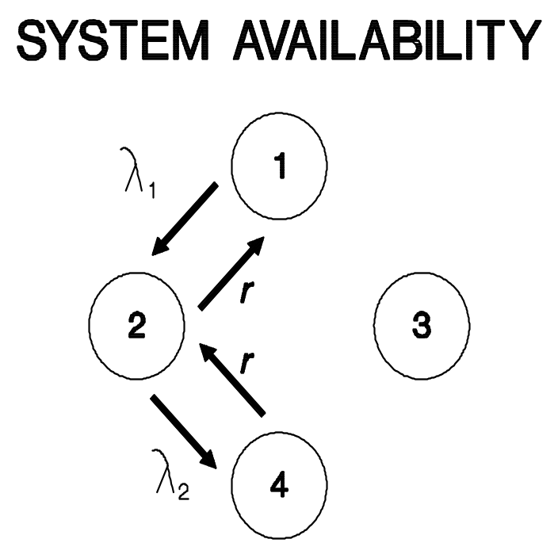
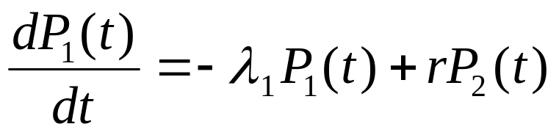
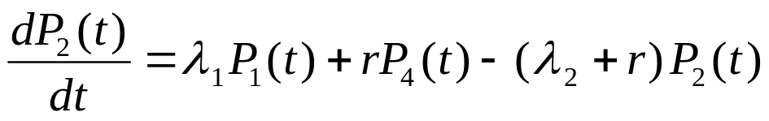

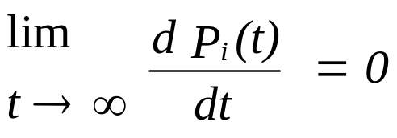
Standby Systems
for steady-state:
and set P_{i}(t) = P_{i}
Chapter 11
Notes:
For a standby system in which the primary unit can be repaired when a failure occurs, Markov analysis can be used to determine the system steady-state availability. In this example, no failures in standby are assumed. Both the failure and repair distributions are assumed to be exponential.

Slide 14
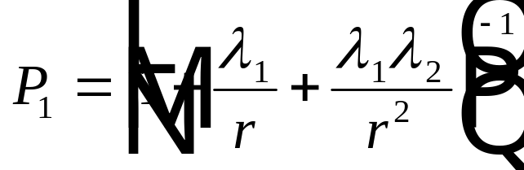
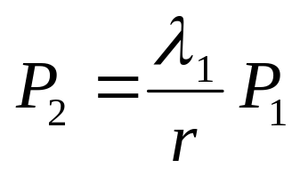
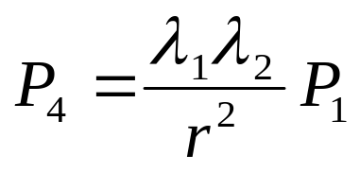
Steady-State Standby Systems
- ₁ P₁ + r P₂ = 0
₁ P₁ + r P₄ - ( ₂ + r) P₂ = 0
P₁ + P₂ + P₄ = 1
A = P₁ + P₂
Chapter 11
Notes:
Under steady-state conditions, the rate of change of the probability of being in state i is zero. This results in the above system of linear equations. These are then solved for the steady-state solution. The argument t in P_{i}(t) is dropped since the probability in steady-state i no longer a function of time.

Slide 15

Generalize - steady-state availability
_{j} Rate into state i from state j x P_{j}
= Rate out of state i x P_{i}
Chapter 11
Notes:
Given a rate diagram, the equations for steady-state availability can be constructed using the above general formula. A linear equations for each of (n-1) states along with the equation showing the sum of the probabilities equaling one must be solved simultaneously.

Slide 16
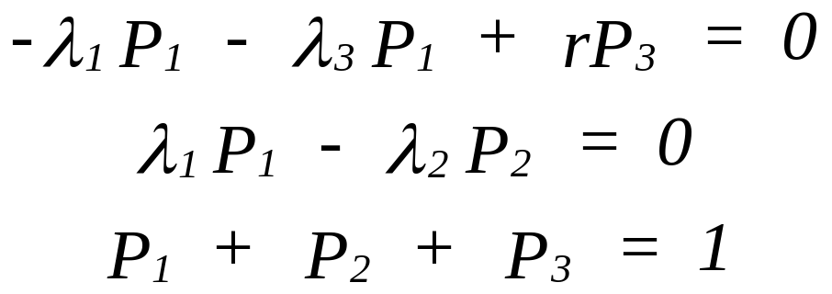

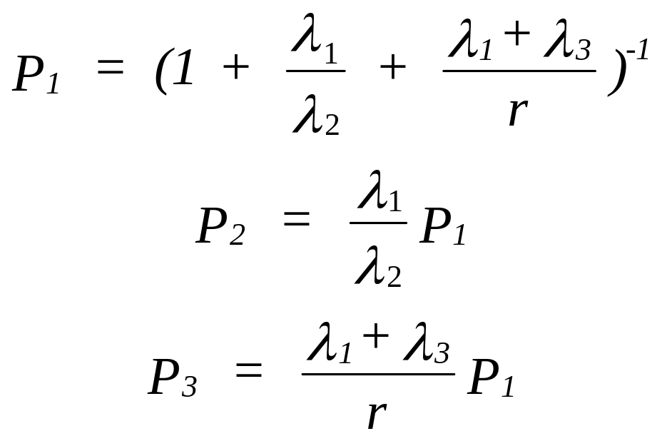
Example #1
1
1
3
r
2
3
2
A = P₁ + P₂
Chapter 11
Notes:
In this example, a single component operates in state 1, is degraded in state 2, and fails in state 3. Only upon failure, can repair be initiated.

Slide 17
Example #2
( ₁ + ₂ ) P1 = r P₄
₂ P₂ = ₁ P₁
₁ P₃ = ₂ P₁
r P₄ = ₂ P₂ + ₁ P₃
P₁ + P₂ + P₃ + P₄ = 1
1
1
2
r
2
3
4
1
2
Chapter 11
Notes:
In this example, there are two active redundant components. Repair occurs only when both components have failed.

Slide 18
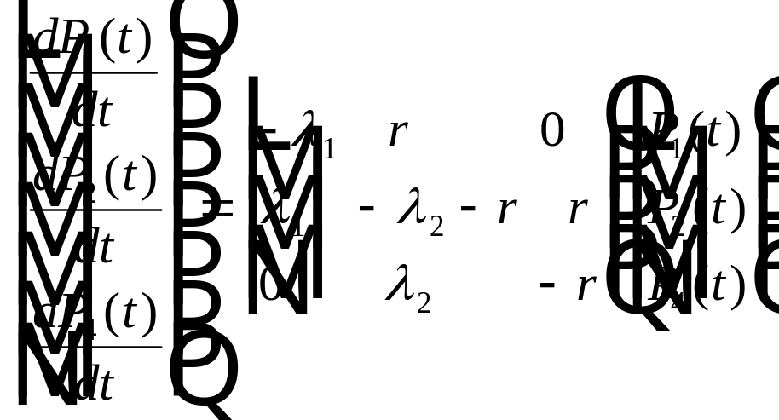

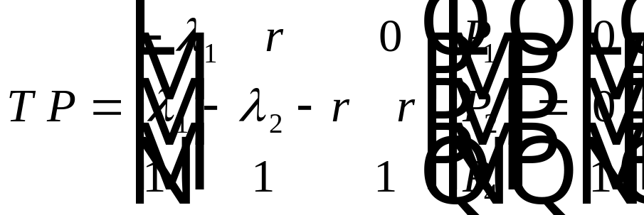
Matrix Approach to Steady-State
P = T⁻¹ b
Chapter 11
Notes:
As the number of components increases, the number of states and equations will increase as well. Formulating the problem using matrices becomes a viable solution approach.

Slide 19
Example
State unit 1 unit 2 unit 3
1 on-line on-line stand
2 failed on-line on-line
3 on-line failed on-line
4 on-line on-line failed
5 failed failed on-line
6 on-line failed failed
7 failed on-line failed
8 failed failed failed
Chapter 11
Notes:
A three component system will two components in series and the third in standby. There are 8 states as defined with the first four states being the system operating states (two components operating).

Slide 20
Example - continued
1
-
1
3
2
2
3
4
3
2
2
3
1
1
5
6
7
1
3
2
8
Chapter 11
Notes:
The corresponding rate diagram. From this rate diagram, a transition matrix is formed.

Slide 21
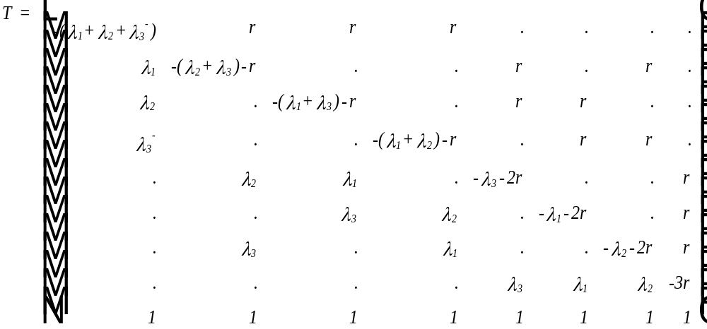
Example - continued
Chapter 11
Notes:
The transition matrix is solved for its inverse. Multiplying the inverse times the vector = [0,0,0,0,0,0,0,1]^{t} will provide the values for P_{i}, i = 1, 2, …, 8.

Slide 22

11.4 Inspect and Repair Model
Let R(t) be the dormant failure distribution,
t₁ = inspection time,
t₂ = repair time if necessary
T = time between inspections
Then T + t₁ + t₂ [ 1 - R(T) ] is the expected cycle time
Time to inspect
and repair?
Chapter 11
Notes:
For components having dormant failures, failures that are not observed until the component is inspected, the frequency of inspection will determine its availability (uptime). When inspection requires some downtime, then there is a trade-off between inspection frequency and availability. The decision variable in the above model is T, the inspection interval.

Slide 23
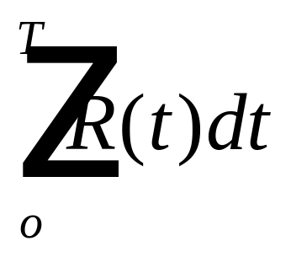
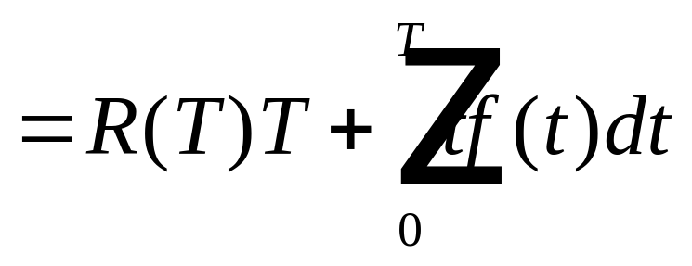
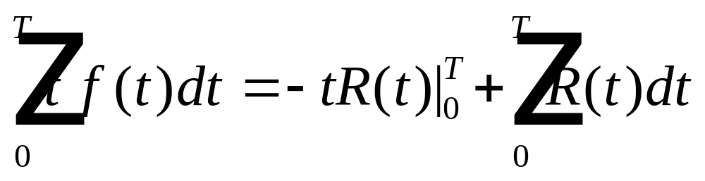
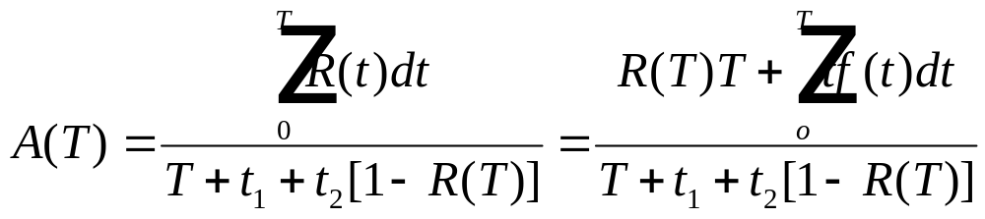
Inspect and Repair Model
Expected uptime =
Chapter 11
Notes:
An interval availability over an inspection interval can be found as shown. The numerator is the expected uptime (T if no failure occurs + partial expected time to failure) and the denominator is the expected cycle time (inspection interval + inspection time + expected repair time).

Slide 24
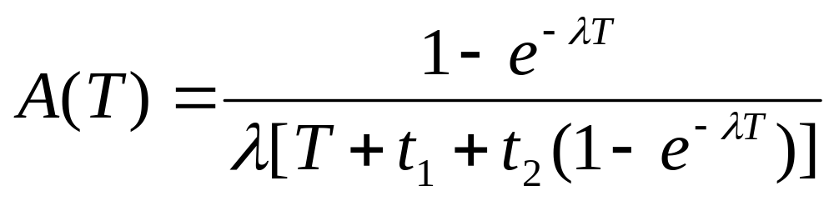
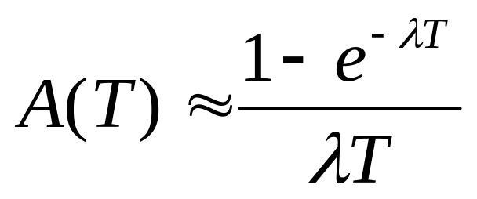
Inspect and Repair Model
Exponential Case
If t₁ and t₂ are negligible
Chapter 11
Notes:
Applying this model to the exponential failure distribution results in the first equation. Assuming that the inspect and repair times are negligible compared to the inspection interval, the second approximation is obtained.

Slide 25
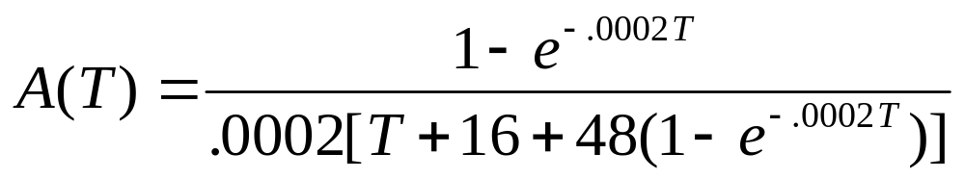
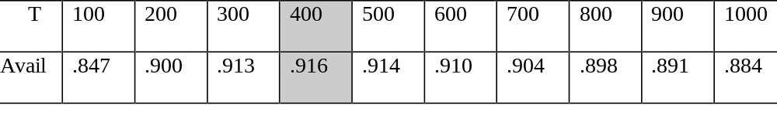
Example
CFR=.0002
resupply time = 48 hr
inspect time = 16 hr.
Chapter 11
Notes:
An example of the exponential case. How would you approach this problem if the failure distribution were Weibull?

